Slide 1

JavaScript – Document Object Modal
Chitradevi M
Technical Trainer
KGiSL Micro College
KGiSL Campus, Coimbatore – 641 035.

Slide 2
Document Object Model (DOM)
The DOM is the structured representation of the HTML document created by the browser. It allows JavaScript to manipulate, structure, and style your website.
<!DOCTYPE html>
<html>
<head></head>
<body>
<h1>Web Technologies</h1>
<button>Change Heading</button>
</body>
</html>

Slide 3
Document Object
It is the entry point of the DOM. For accessing any HTML Element, you should always start with accessing the document object first.
HTML DOM Tree
The DOM tree represents an HTML document as nodes. Each node is referred to as an Object.

Slide 4
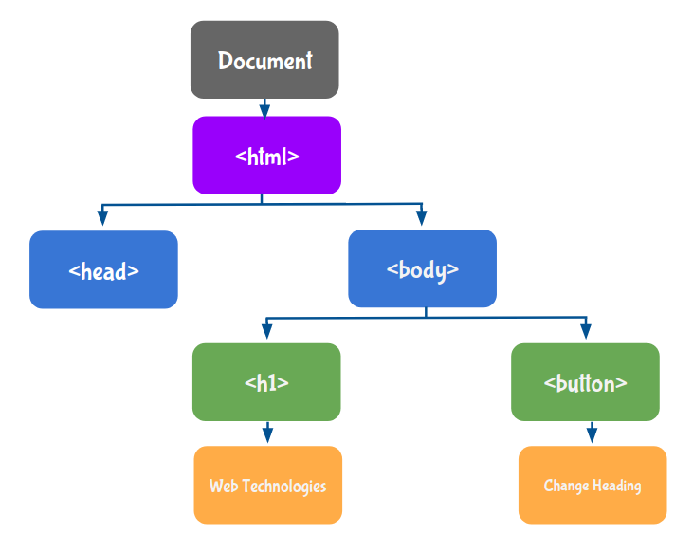

Slide 5
Accessing field value by document object
In this example, we are going to get the value of input text by user. Here, we are using document.form1.name.value to get the value of name field.
Here, document is the root element that represents the html document.
form1 is the name of the form.
name is the attribute name of the input text.
value is the property, that returns the value of the input text.

Slide 6
<script type="text/javascript">
function printvalue(){
var name=document.form1.name.value;
alert("Welcome: "+name);
}
</script>
<form name="form1">
Enter Name:<input type="text" name="name"/>
<input type="button" onclick="printvalue()" value="print name"/>
</form>

Slide 7
Javascript - document.getElementById() method
The document.getElementById() method returns the element of specified id.
In the previous page, we have used document.form1.name.value to get the value of the input value. Instead of this, we can use document.getElementById() method to get value of the input text. But we need to define id for the input field.

Slide 8
<script type="text/javascript">
function getcube()
{
var number=document.getElementById("number").value;
alert(number*number*number);
}
</script>
<form>
Enter No:<input type="text" id="number" name="number"/><br/>
<input type="button" value="cube" onclick="getcube()"/>
</form>

Slide 9
getElementById
The getElementById() method helps to select the HTML Element with a specific ID.
console.log(document.getElementById("headingElement"))
Properties
textContent
To manipulate the text within the HTML Element, we use textContent
Property.
Style
The style property is used to get or set a specific style of an HTML Element using different CSS properties.
Use Camel Case naming convention (starting letter of each word should be in the upper case except for the first word) for naming the Style Object Properties. For example,color, fontFamily , backgroundColor , etc.

Slide 10
Events
Events are the actions by which the user or browser interacts with the HTML Elements. Actions can be anything like clicking a button, pressing keyboard keys, scrolling the page, etc.
Onclick Event
The onclick event occurs when the user clicks on an HTML Element. We will give the name of the function as a value for the HTML onclick attribute.
<body>
<h1 id="headingElement">Web Technologies</h1>
<button onclick="manipulateStyles()">Change Heading</button>
</body>
function manipulateStyles() {
document.getElementById("headingElement").textContent = "4.O Technologies";
document.getElementById("headingElement").style.color = "blue";
}

Slide 11
Javascript - document.getElementsByName() method
The document.getElementsByName() method returns all the element of specified name.
The syntax of the getElementsByName() method is given below:
document.getElementsByName("name")
<script type="text/javascript">
function totalelements()
{
var allgenders=document.getElementsByName("gender");
alert("Total Genders:"+allgenders.length);
}
</script>
<form>
Male:<input type="radio" name="gender" value="male">
Female:<input type="radio" name="gender" value="female">
<input type="button" onclick="totalelements()" value="Total Genders">
</form>

Slide 12
Javascript - document.getElementsByTagName() method
The document.getElementsByTagName() method returns all the element of specified tag name.
The syntax of the getElementsByTagName() method is given below:
document.getElementsByTagName("name")
<script type="text/javascript">
function countpara(){
var totalpara=document.getElementsByTagName("p");
alert("total p tags are: "+totalpara.length);
}
</script>
<p>This is a pragraph</p>
<p>Here we are going to count total number of paragraphs by getElementByTagName() method.</p>
<p>Let's see the simple example</p>
<button onclick="countpara()">count paragraph</button>

Slide 13
Javascript – innerHTML
The innerHTML property can be used to write the dynamic html on the html document.
It is used mostly in the web pages to generate the dynamic html such as registration form, comment form, links etc.
Example of innerHTML property
In this example, we are going to create the html form when user clicks on the button.
In this example, we are dynamically writing the html form inside the div name having the id mylocation. We are identifing this position by calling the document.getElementById() method.

Slide 14
<html>
<body>
<script type="text/javascript" >
function showcommentform() {
var data="Name:<br><input type='text' name='name'><br>Comment:<br><textarea rows='5' cols='50'></textarea><br><input type='submit' value='comment'>";
document.getElementById('mylocation').innerHTML=data;
}
</script>
<form name="myForm">
<input type="button" value="comment" onclick="showcommentform()">
<div id="mylocation"></div>
</form>
</body>
</html>

Slide 15
Javascript – innerText
The innerText property can be used to write the dynamic text on the html document. Here, text will not be interpreted as html text but a normal text.
It is used mostly in the web pages to generate the dynamic content such as writing the validation message, password strength etc.

Slide 16
<!DOCTYPE html>
<html>
<body>
<script type="text/javascript" >
function validate() {
var msg;
if(document.myForm.userPass.value.length>5){
msg="good";
}
else{
msg="poor";
}
document.getElementById('mylocation').innerText=msg;
}
</script>
<form name="myForm">
<input type="password" value="" name="userPass" onkeyup="validate()">
Strength:<span id="mylocation">no strength</span>
</form>
</body>
</html>

Slide 17
DOM Manipulations
The htmlFor Property
We can use htmlFor property to add HTML for attribute to the HTML label element.
let labelElement = document.createElement("label");
labelElement.htmlFor = "myCheckbox";
The setAttribute () Method
We can use setAttribute() method to set any HTML attribute name and its corresponding value. If the attribute already exists, the value is updated. Otherwise, a new attribute is added with the specified name and value.
Syntax:
Element.setAttribute(name, value);
let labelElement = document.createElement("label");
labelElement.setAttribute("for", "myCheckbox");

Slide 18
Loops allow us to execute a block of code several times.
for...of Loop
for...in Loop
The for...of Loop
let myArray = [1, 2, 3, 4];
for (let eachItem of myArray) {
console.log(eachItem);
}
The for...in Loop
let myArray = [1, 2, 3, 4];
for (let eachItem in myArray) {
console.log(eachItem);
}

